Slide 1
Optimal Housing Locations in A New City

Slide 2
Data Science Problem
A musician is planning to move to Manhattan. Music work requires access to a number of different venues for employment.
The ideal place to live would be closest to the greatest number of venues, to save on transportation costs.
What neighborhood contains the greatest number of venues for potential employment?
Create a map that shows all music venues in Manhattan, available through the Foursquare API, relative to neighborhood.

Slide 3
Data and Data Cleaning
json file that contains geographic data for New York City.
Original dataset had 5 boroughs and 306 neighborhoods
Clean data by extracting only those rows containing data for the borough of Manhattan
Transform cleaned dataset into a dataframe
Final dataframe has 1 borough and 40 neighborhoods
Dataset obtained from the Foursquare API that shows all music venues in Manhattan
Filter results to exclude venues that have no performance opportunities

Slide 4
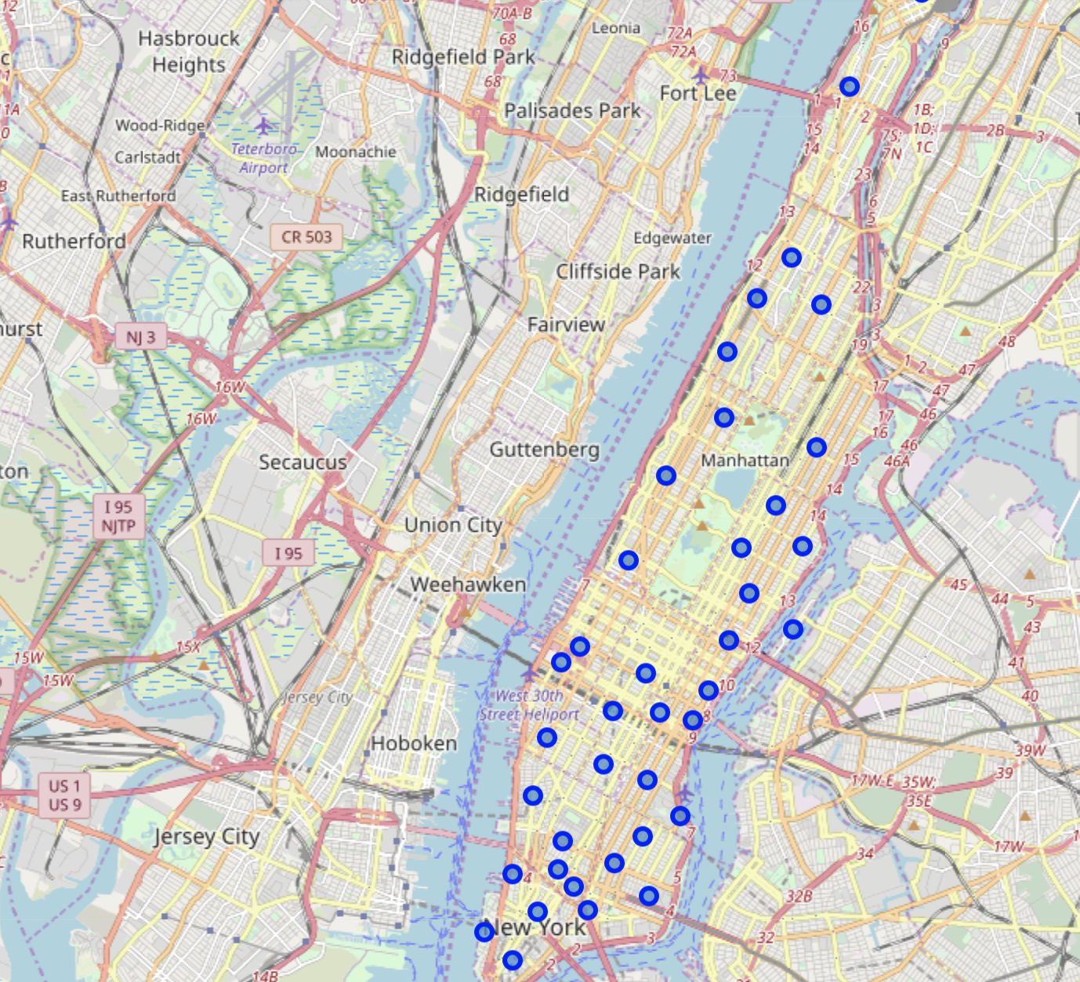
Create a Folium Map of Manhattan
Circle markers on the map show the centroid of each neighborhood in Manhattan

Slide 5
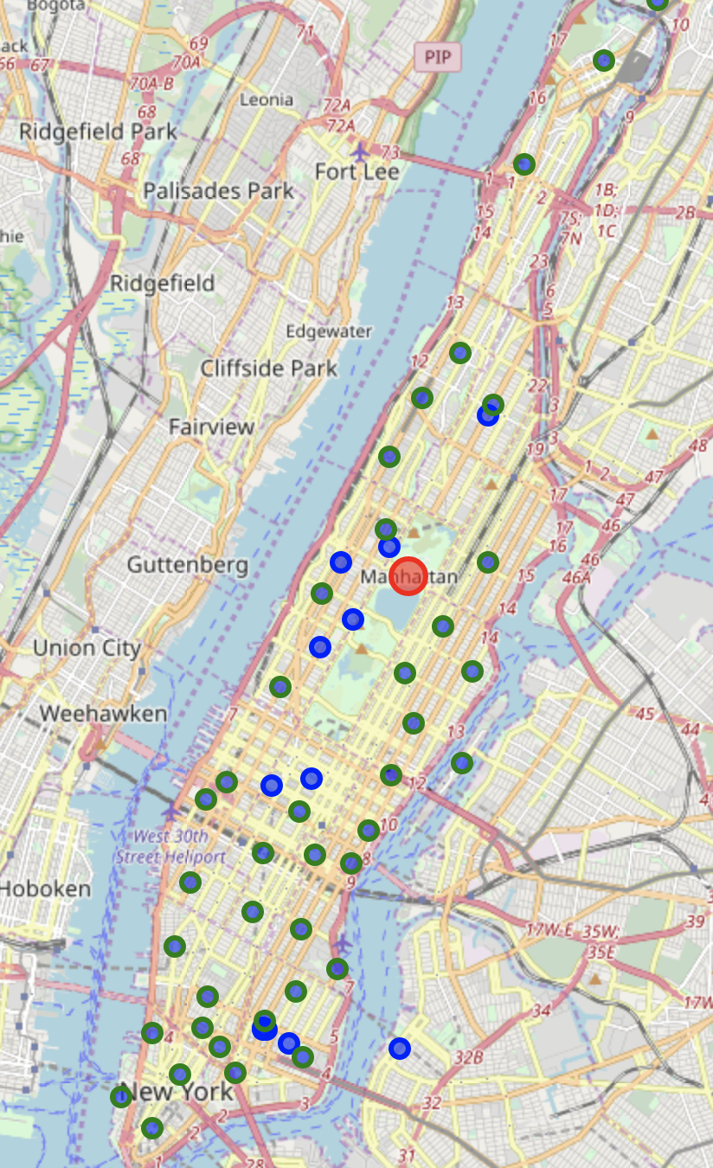
Display Foursquare API Search Results on Map
Venues are shown with blue circle markers and neighborhood centroids are shown with green circle markers
Analyze results to find the neighborhoods that contain the greatest number of venues

Slide 6
Results
The following neighborhoods are in close proximity to clusters of music venues:
Manhattan Valley
Upper West Side
Midtown
NoHo
Lower East Side
The musician planning to move to the city should concentrate a housing search in any one of these neighborhoods, in order to be close to prospective employment venues.

Slide 7
Conclusion
This project was intended to be a simple exercise that could be helpful to a musician planning to move to NYC.
The results of the project could also be useful in a marketing situation, in which a company seeks to target a marketing strategy toward a particular audience, such as people who frequent neighborhoods with many live music venues.

